Slide 1

Fly to the world of returns

Slide 2

International insights & challenges
Belgian insights

Slide 3
International insights & challenges
Belgian insights

Slide 4









Belgium’s leading postal operator and a growing parcel & omni-commerce logistics partner in Europe, North-America and Asia.
Fulfilment & Logistics
HQ Brussels
Delivery Solutions
Life Cycle Solutions
Present in over 10 countries in 4 continents
Over 80 hubs for e-commerce logistics, spread over our 13 entities.
Offers services in over 200 destinations

Slide 5

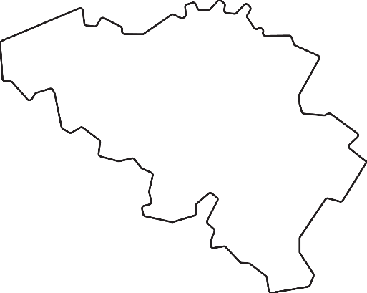
We have developed activities and entities around the world to meet the changing needs of our customers.
Belgium
Eurasia
North America
Average 5.74 million letters and 582,000 parcels/day
5 industrial sorting centers
2,800 service points in Belgium
14 e-commerce fulfilment centers in Europe
3 international delivery hubs
More than 220 destinations
46 e-commerce fulfilment and warehousing locations in the USA, Canada, Australia and New Zealand.
More than 400 million parcels in 2021

Slide 6

348 Billion
171 Billion
Source : Statista 2023

Slide 7

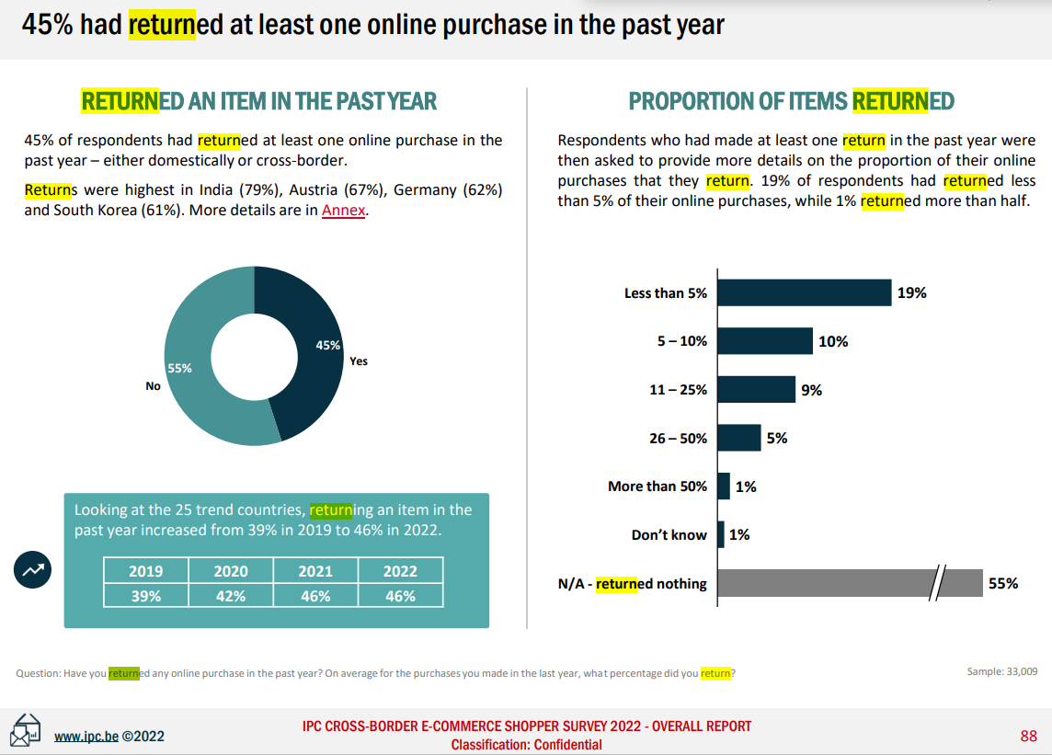
Return rates
Returned an item in the past year :
A growing number…
Proportions of items returned :
45%
Source : IPC Cross border e commerce shopper survey 2022

Slide 8

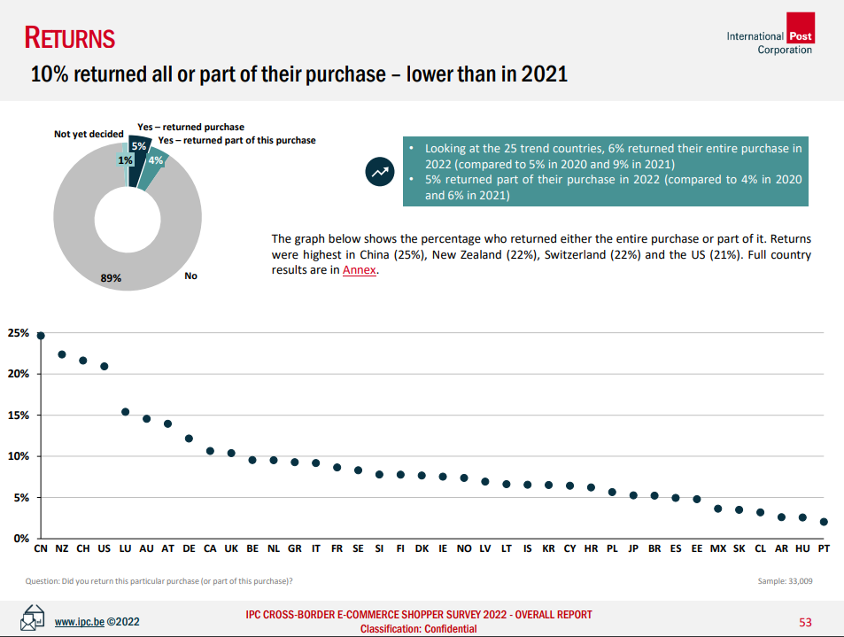
10% returned all or part of their purchase
Returns were highest in :
China (25%)
New Zealand (22%)
Switzerland (22%)
and the US (21%)
Source : IPC Cross border e commerce shopper survey 2022

Slide 9

Returns location preference
Source : IPC Cross border e commerce shopper survey 2022

Slide 10
Challenge: impact
of merchants feel their returns process has a significant impact on their sales. ¹
of your visitors will shop elsewhere if you don’t offer an easy returns solution.³
97%
62%
For 86% of consumers, a simple and reliable returns process is a must.²
41%
86%
of the returns are handled by the Post.²
1 IPC Cross border e-commerce shopper survey 2022 / Happy returns
2 IPC shopper survey Key findings report 2022
^{3 DHL.com.}
10

Slide 11
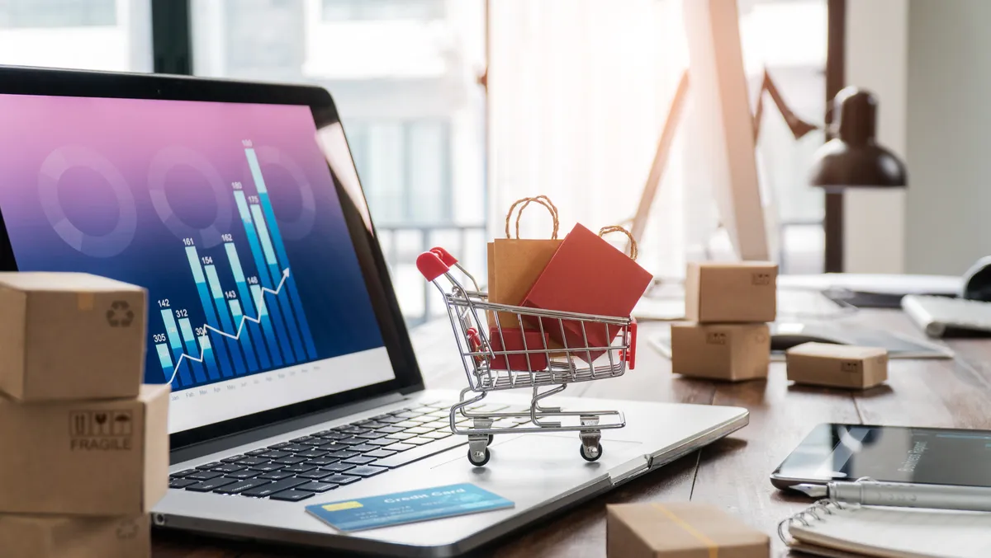
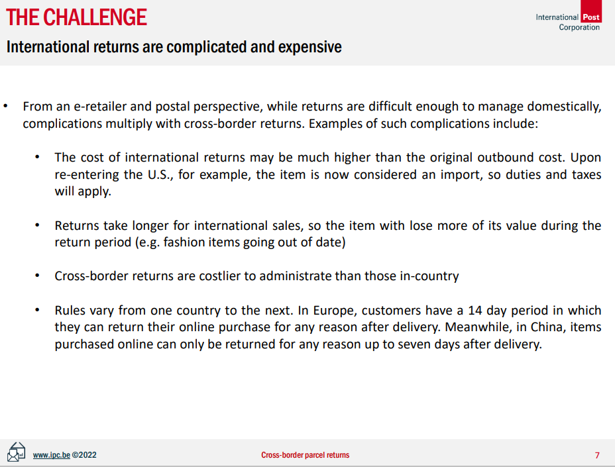
Challenge: Complications & cost
International returns are complicated and expensive :
Higher costs
Take longer
Extra administrations
Rules vary
Source : IPC Cross border e-commerce shopper survey 2022

Slide 12

Challenge: European law
.
.
.
.
14-day period to change your mind
Examine
Refund
Clear communication

Slide 13
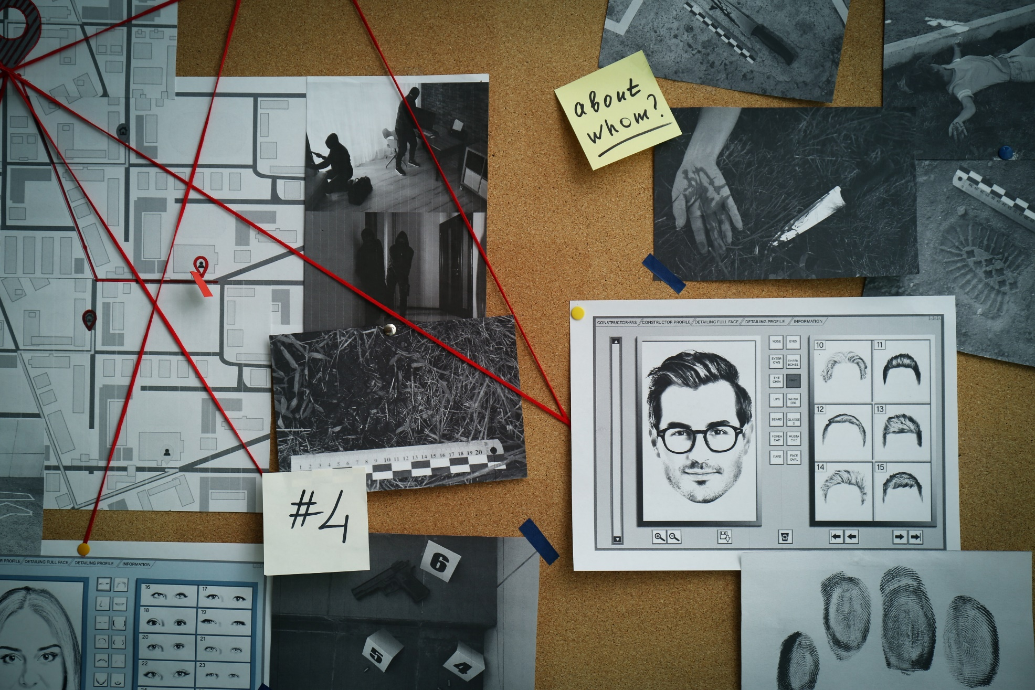
Challenge: serial returners
There is a clear difference between "normal" returns and repeated/abusive returns.
There are two types of consumer profiles who regularly make returns:
The "wardrober" or "renter"
The bracketing/fitting roomer
  »
Sources : shopify.com / dhl.com

Slide 14


Slide 15

Challenge: conclusion
.
Sales Impact
Complications & cost
Law
Serial returners
Sustainability
Returns create both a challenge and opportunity for retailers !

Slide 16
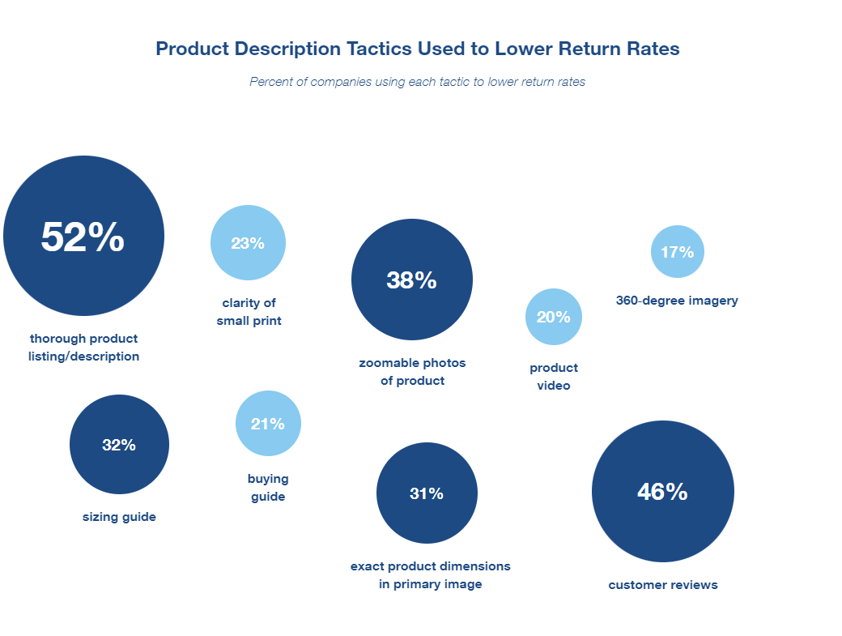



How can we better manage returns?
Communications to minimize returns
Simplify the shipment process
Smart product return & recovery solutions
Return date analysis
Sources : https://www.uspsdelivers.com/reverse-logistics-insights

Slide 17
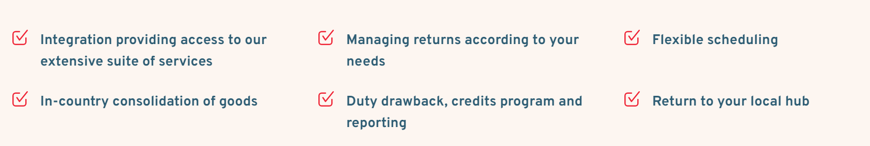
Our returns management
We offers 2 solutions for international returns
Easy Return
For untracked returns up to 2kg
Global Tracked Return
For tracked returns up to 30kg

Slide 18

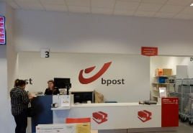
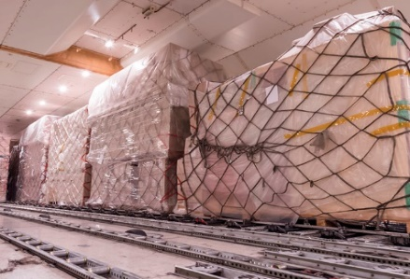
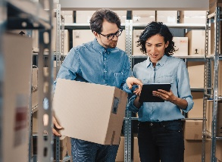
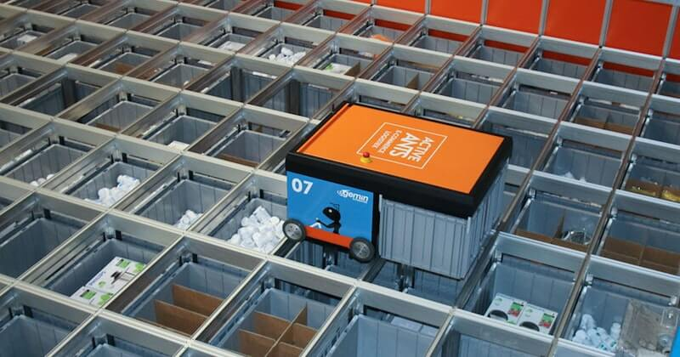
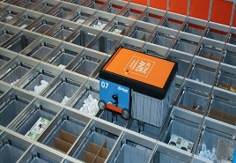

Returns
Pickup, return, handling, grading, storage and re-use of products
National returns
Simple & user-friendly
2,300 manned return locations
Returns via bpost locker network
International returns
Integrated with International carriers
Customs support
Warehouse returns
Sortation, grading
Re-packaging
Testing, repair
We make returns easy
We help our clients to
reduce costs
improve efficiency
enhance the experience

Slide 19
International insights & challenges
Belgian insights

Slide 20


Slide 21

Return rates in Belgium
of Belgians returned one or more purchases over the year
48%
of parcels are returned or planned to be returned
14,6%
for shoes
28%
Source : IPC / Online tracker bpost full year 2022 / Online tracker bpost Q2 2023, YTD

Slide 22
Return rates in Belgium by product category
Returning by product category (YTD 2023) (n=7704 parcels)
total
Source : Online tracker bpost Q2 2023. Q: Have you returned the product(s) ordered from the parcel or do you plan to do so?

Slide 23
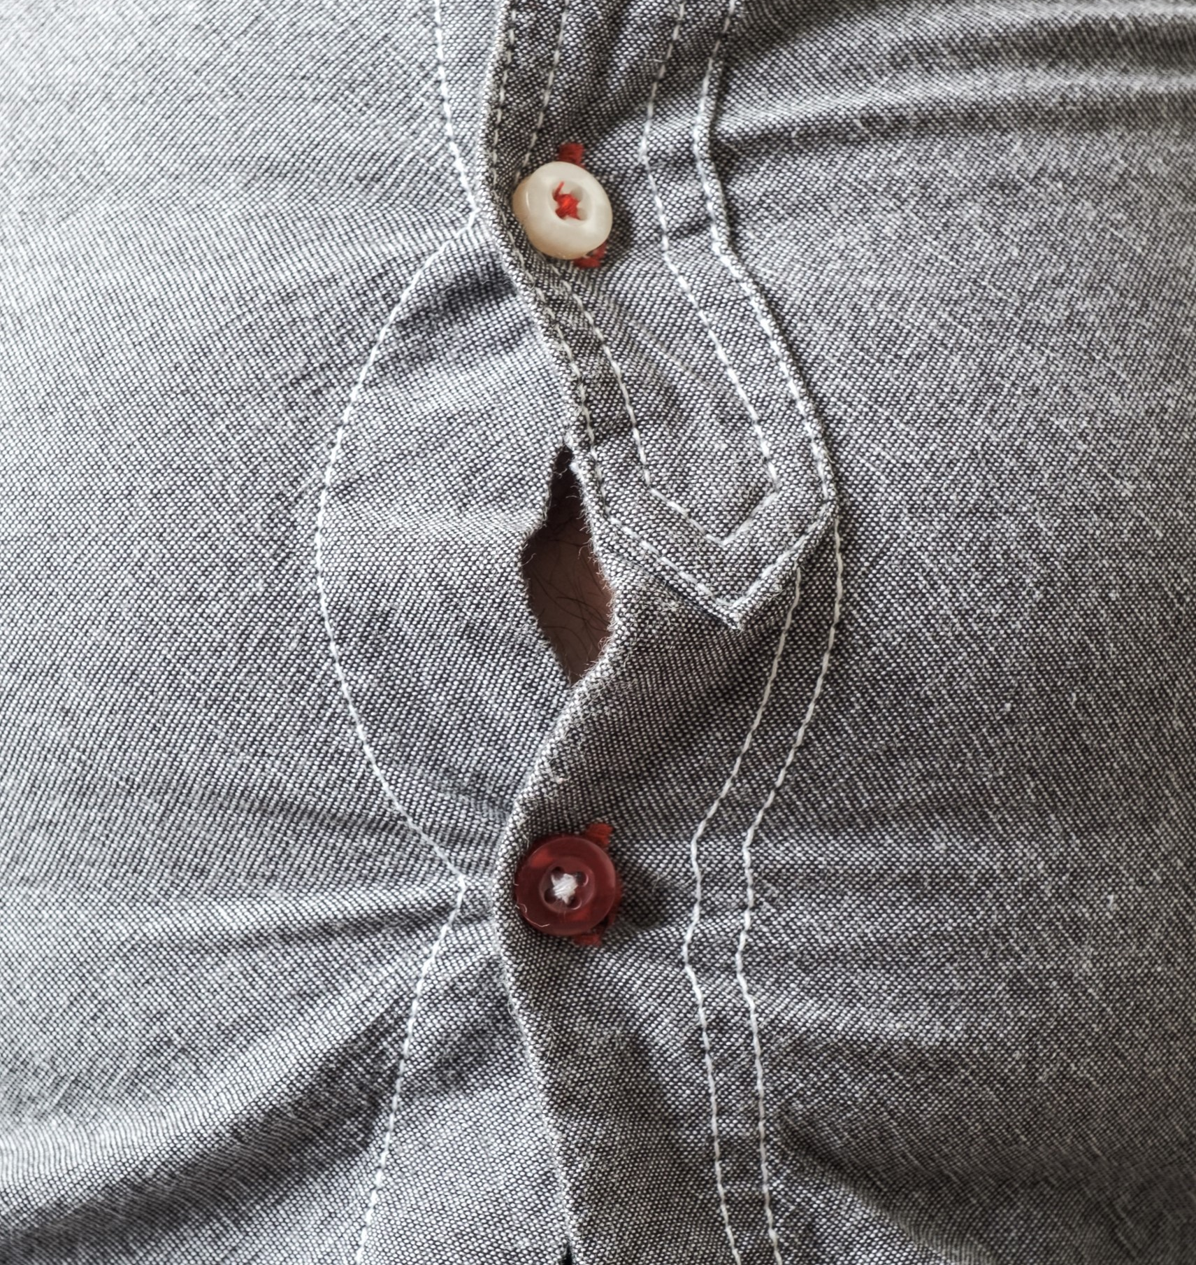
What are the reasons for returns?
The size was wrong
Source : Online tracker bpost Q2 2023. Reasons for returning a parcel in general (YTD 2023). (n= 7704 parcels).

Slide 24
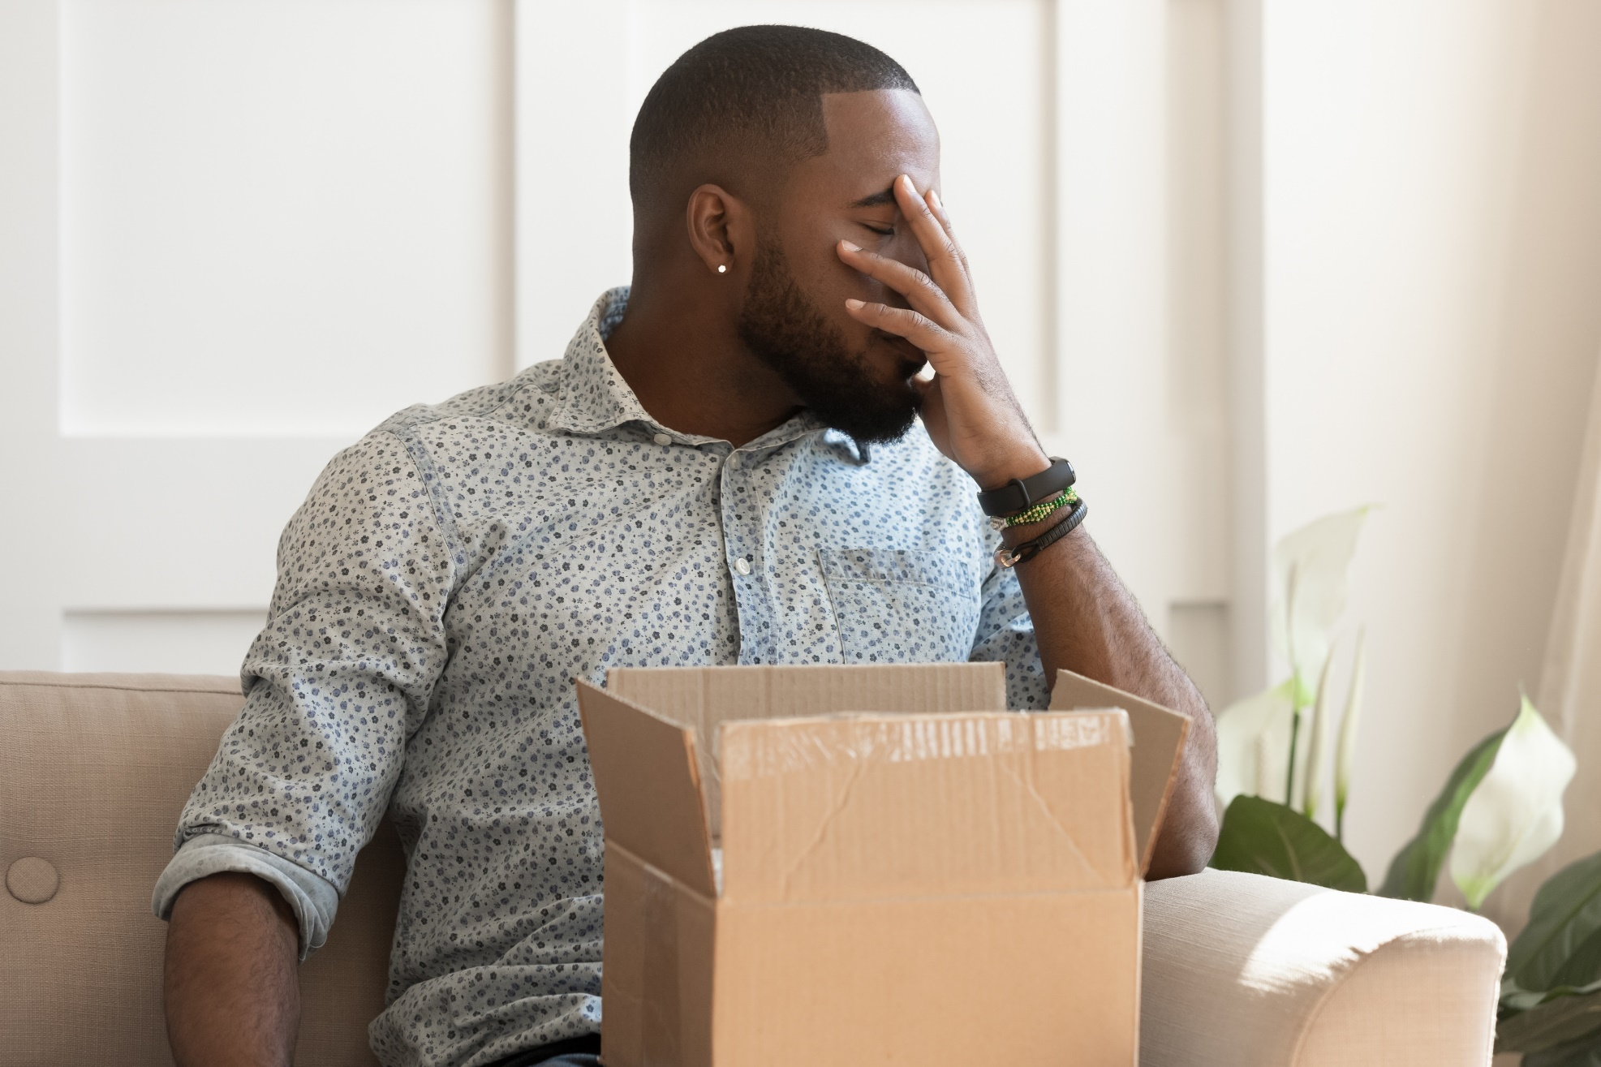
What is the profile of people who make returns?
Men
Source : Online tracker bpost 2022

Slide 25

What is the profile of people who make returns?
18-34
Source : Online tracker bpost 2022

Slide 26

54%
33%
43%
76%
Label
Immediately
Post office
Free
Source : Online tracker bpost Q2 2023

Slide 27

Free returns ?
For 59% of consumers, offering free returns is an important element of an ideal online shop…
E-consumers say they will stop ordering goods online if it requires them to cover the full cost of return !
Loi Europe faire payer retours ?
Source : Safeshops.be Belgian Online Shopper Survey 2022 / tnpconsultants.com

Slide 28


Free returns
Reassuring argument but…

Slide 29

But finally… Free returns : yes or no ?

Slide 30

Yes or no ?
It's not a child's play

Slide 31

Be a superhero

Slide 32

Be a superhero
Reliable & simple
A reliable and simple return procedure is important for
80% of Belgians
Source : IPC, IPC cross-border e-commerce shopper survey 2020, Bpost Parcel receiver understanding (2018)

Slide 33

Be a superhero
Choice
Consumers want to have a range of options to drop their parcels
Source : IPC, IPC cross-border e-commerce shopper survey 2020

Slide 34
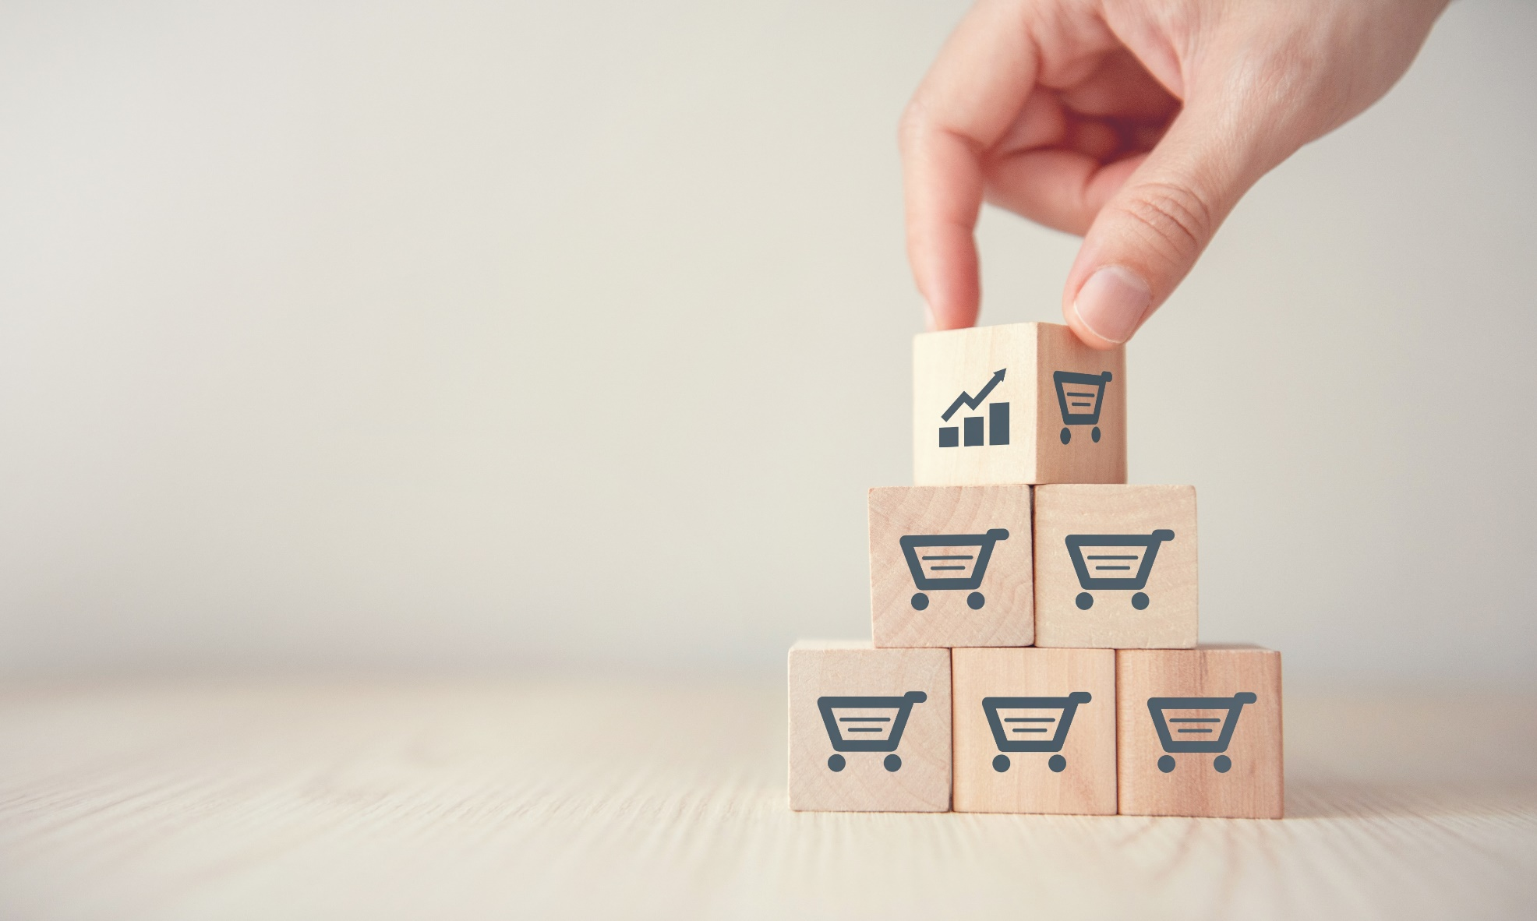
Do business
  Research shows that 92% of consumers are incentivized to purchase items from a retailer that offers an easy returns process
Source : https://www.parcelandpostaltechnologyinternational.com

Slide 35


Slide 36


Slide 37

Digital
Data
Convenience
Green

Slide 38

“Returns…
it is inherent to the business.
In itself it is part of the game, isn’t it ? “

Slide 39
Thank you and have a safe flight home

