Slide 2
Arnaud Dura
International Business Developer
Bizon

Slide 3
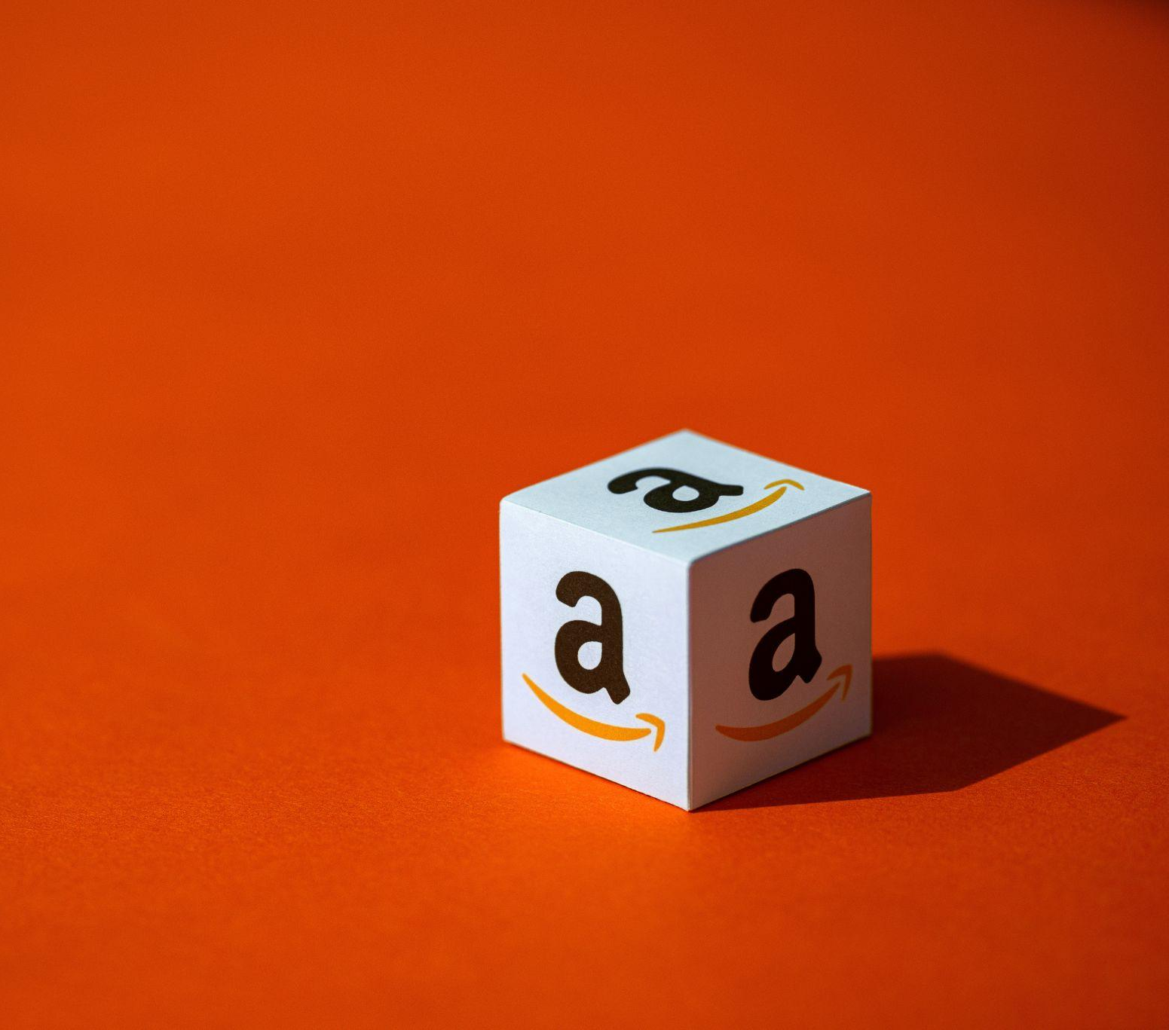
INTRO
E-commerce
& Amazon
Consumer behaviours are shifting all around the globe. As the leader in the e-commerce industry and with a presence in 19 markets, Amazon represents a great doorway to the world.

Slide 4
AMAZON KEY FIGURES
masca
66%
87%
52%
66% of product searches worldwide in 2022 will start on Amazon
87% of consumers are more inclined to buy from Amazon than from any other e-commerce site
52% of online purchases are made on marketplaces
Source: Wundermann, Feedvisor, Synadiet

Slide 5
WHY SHOULD YOU SELL ON AMAZON?
Manage your brand
Boost brand awareness
Grow sales
Win market shares
Adapt with local marketing

Slide 6
Retail media is
the 3rd wave of digital.
Catch it now,
or you'll be swimming against the current later.
Notes:
Présentations liées : Pitch FR, Lancement FR
Source 20 Milliards : https://adage.com/article/datacenter/amazon-ad-and-promotion-spend-topped-20-billion-2022-new-record/2468861

Slide 7
ALL ABOUT US
Who’s
Bizon
The agency dedicated to boost and distribute brands on Amazon.

Slide 8
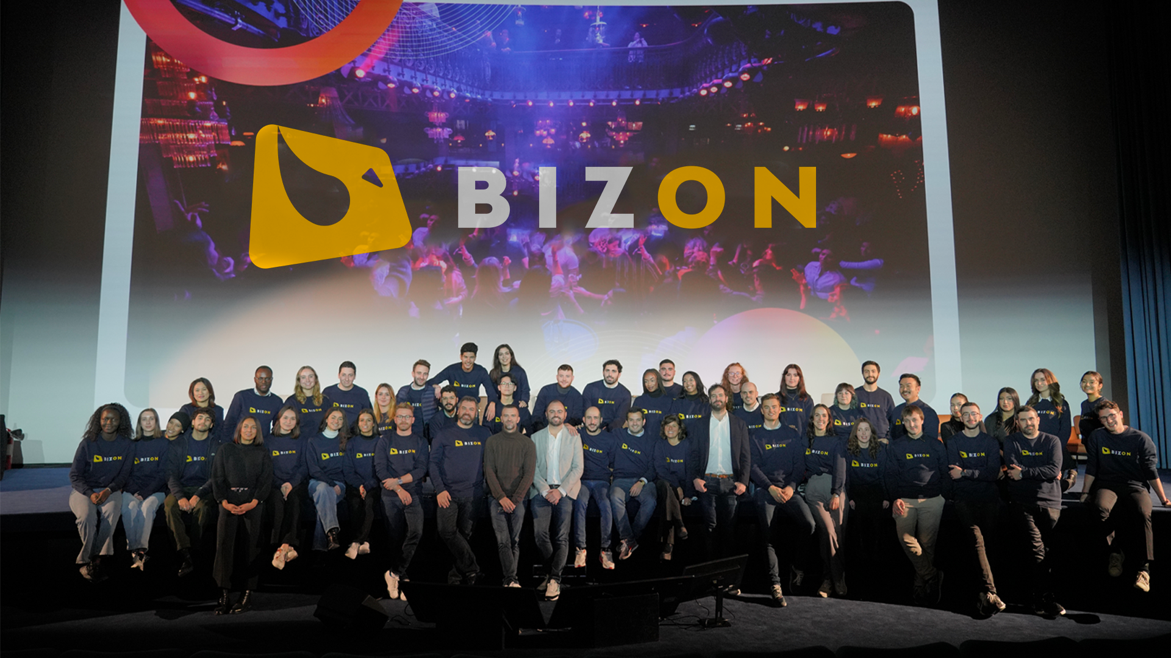
70 experts.

Slide 11
LA CROISSANCE CONTINUE
#169
in Europe
#21
in e-commerce
TOP 20
in France

Slide 13
MORE THAN A MEDIA AGENCY
✓
Strategic Consulting
✓
Brand content, graphic design, marketing, SEO
C
✓
Retail operations
✓
Distribution
✓
Retail Media
A UNIQUE EXPERTISE

Slide 14
A PROVEN METHODOLOGY
Reflection
Foundation
Activation
Audit and Analysis
Performance audit
Thematic analysis
competitive universe
catalog quality
performance advertising
Strategy
Amazon implementation strategy
Vendor to Seller Migration
Amazon Coaching
Amazon Workshop
Reporting
The Essentials
Writing optimized product sheets
Vendor - Seller Integration
Translation
Audit & visual guidelines
E-Merchandising content
Brand Registry
Creation of visual content
A+ pages
Amazon Brand Store
Training
Retail Media management :
Amazon Sponsored Ads and DSP management
Programmatic solution
Retail Operations management :
Support on the themes :
strategic
operational
brand content and studio
analysis and reporting
organizational
Performance Management
Delegated management of your sales on Amazon

Slide 15
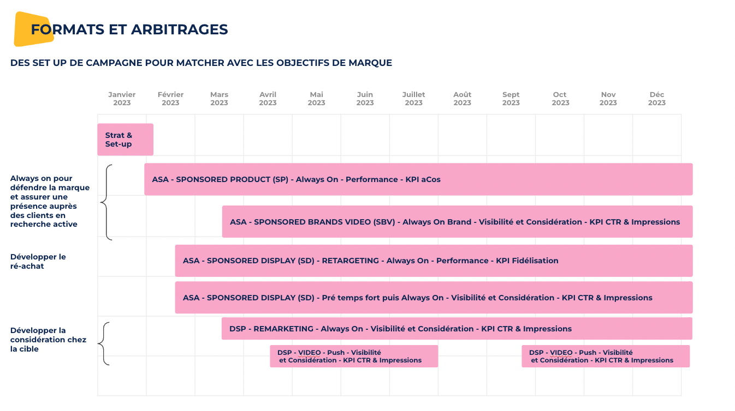
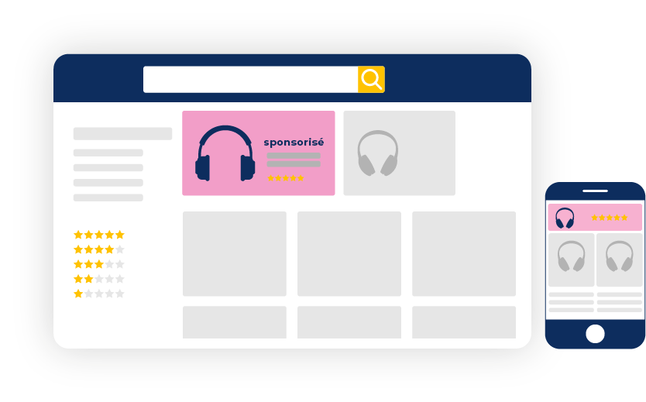
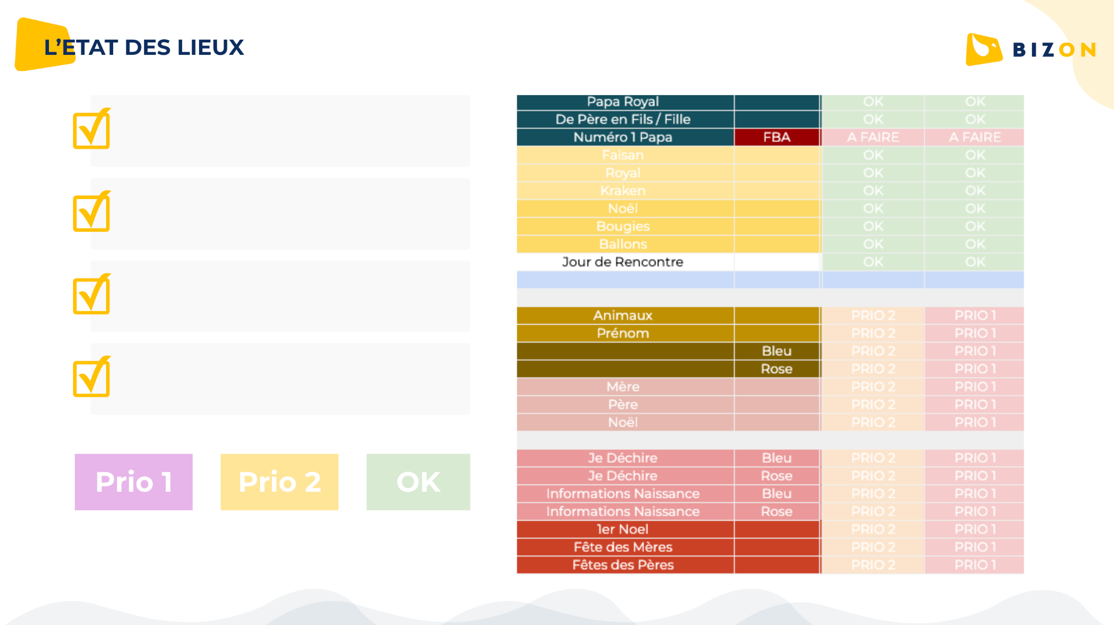
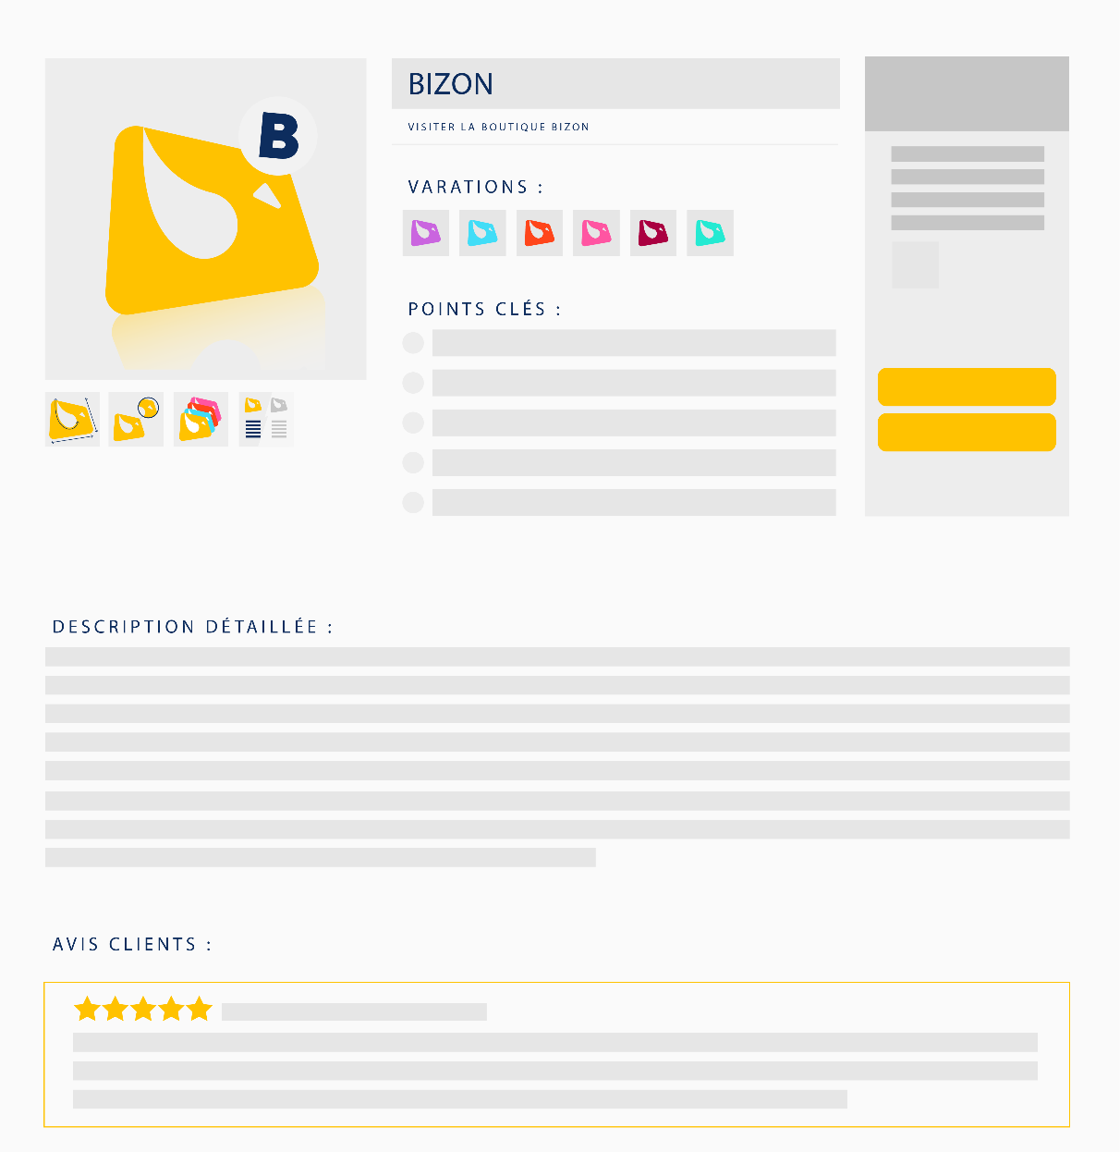
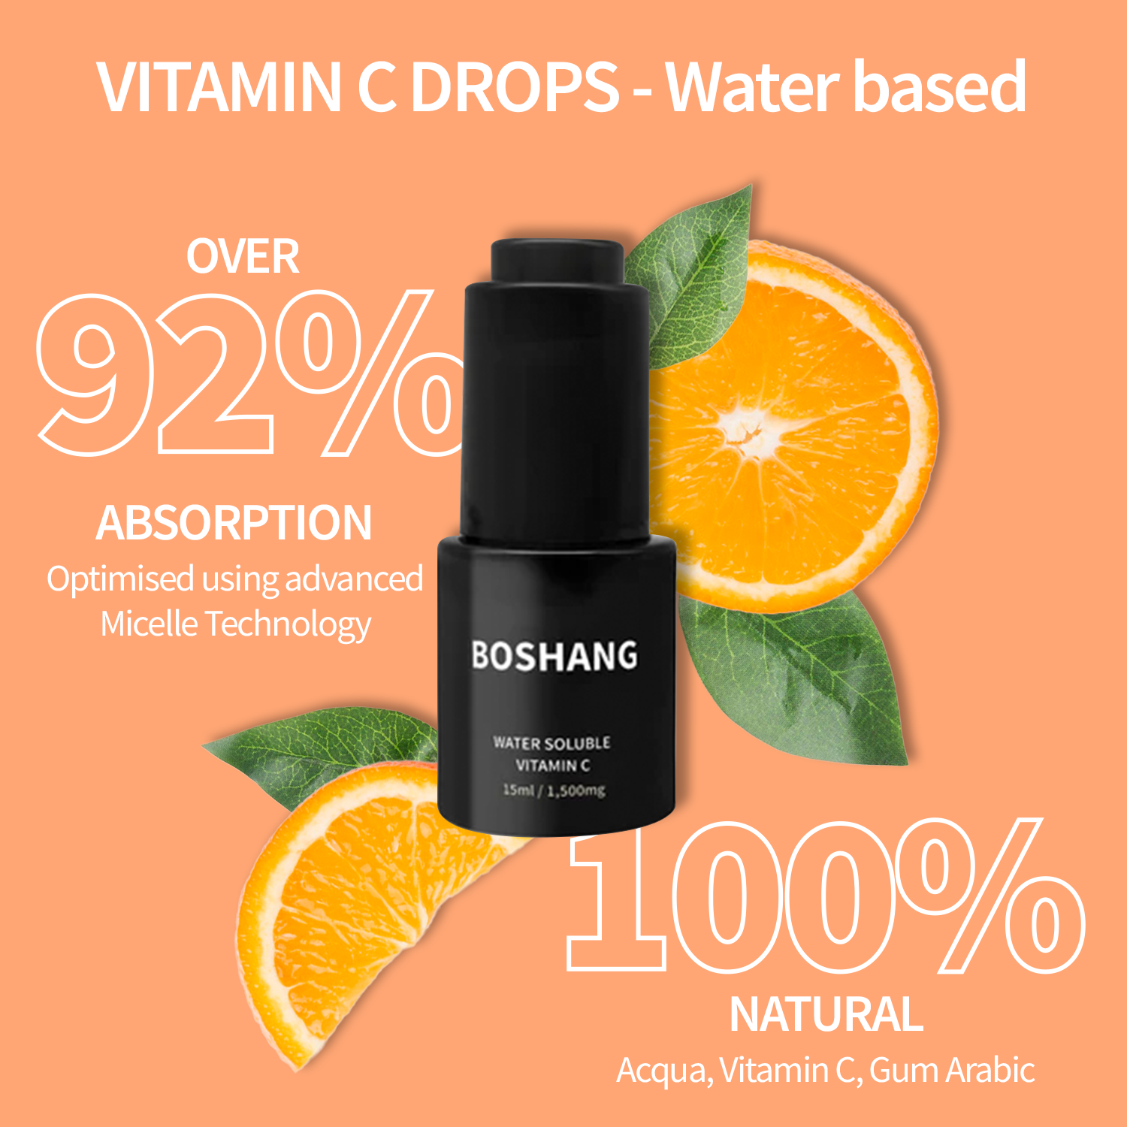
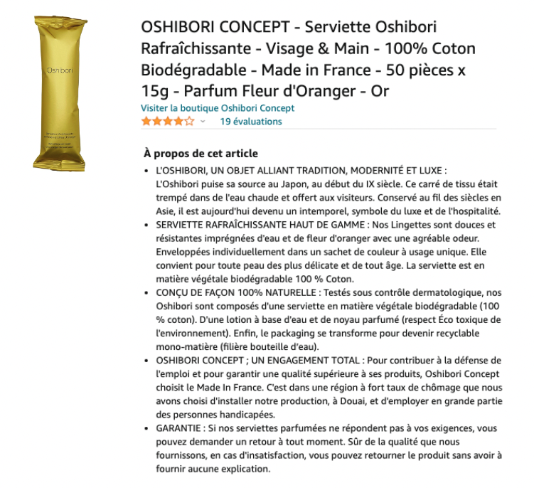
RETAIL MEDIA
OPERATIONAL EXCELLENCE
Distribution • Product availability
Sales Development
OWNED MEDIA
Brand content

Slide 16
CASE STUDY
From New Zealand
to global
Deep dive into what launching multiple countries on Amazon looks like for a company in the food and beverage industry.

Slide 17
x
WHO IS HEILALA VANILLA?
A beautiful story to tell
Heilala Vanilla was born from the collaboration of a family with another, the Ross Family in New Zealand and the Latu family in the Polynesian Island nation of Tonga. It all started back in 2002, in the wake of devastating Cyclone Waka. A couple of decades later, the brand has made it to some of the most renowned chef's tables. Gina DePalma (New York), Ken Takayama (California) and Peter Gordon (London) love it.
The brand puts the respect of nature and its community at the heart of its approach. Every step of the process values local families, farmers, and vanilla plants alike, from harvesting to production, thus providing consumers with the very best of Madagascan variety vanilla.

Slide 18
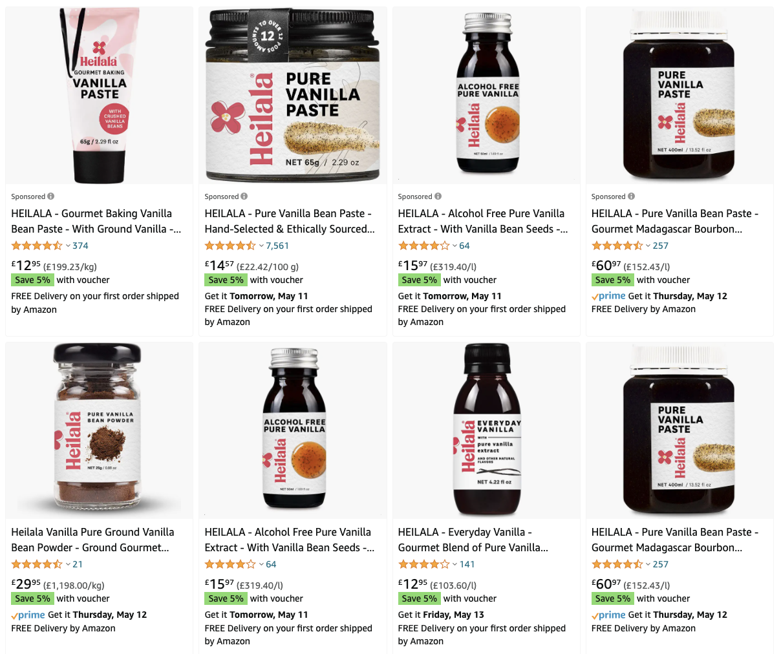
x
THEIR STARTING POINT
Present on Amazon
Already selling with a ROAS of 3.2
Content in need of an update
A brand with great potential
Stock issues and little knowledge
Slowing sales and operations

Slide 19
x
HOW BIZON CONTRIBUTED
Analyze your market & know your P&L
Category, competitors, maturity, consumers
Set up your account & brand registration
for a smoother journey
Set up your operational
game plan
to manage your Amazon journey & activate performance levers
Product selection & logistics
Define your catalog & how to have it in stock and deliver your products
Create optimized brand content
to stand out against competitors, boost brand awareness and start selling
Step #1
Step #3
Step #5
Step #2
Step #4
REFLECTION
FOUNDATIONS
ACTIVATION
Notes:
step 1 = 3 (+financial analysis)

Slide 20
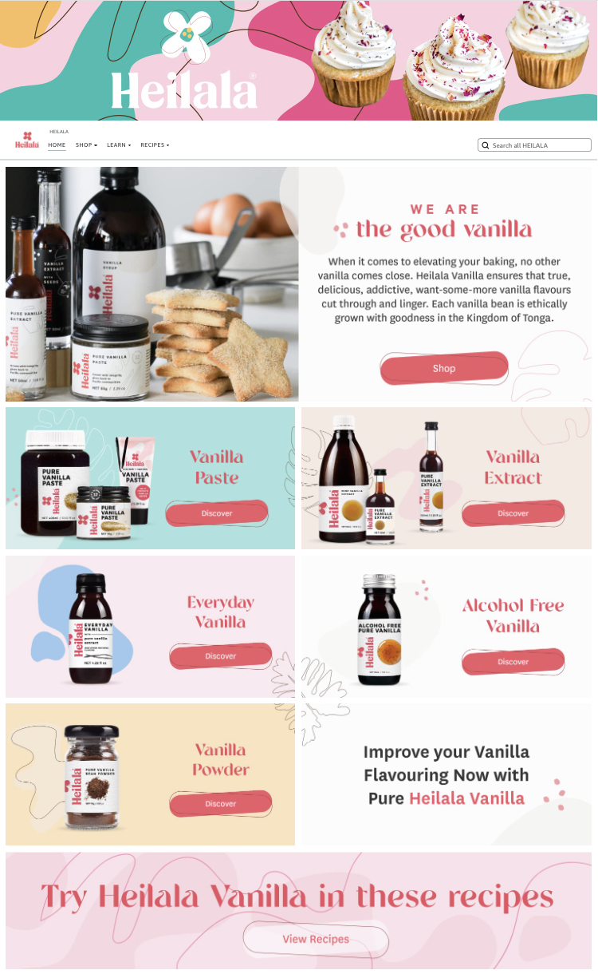
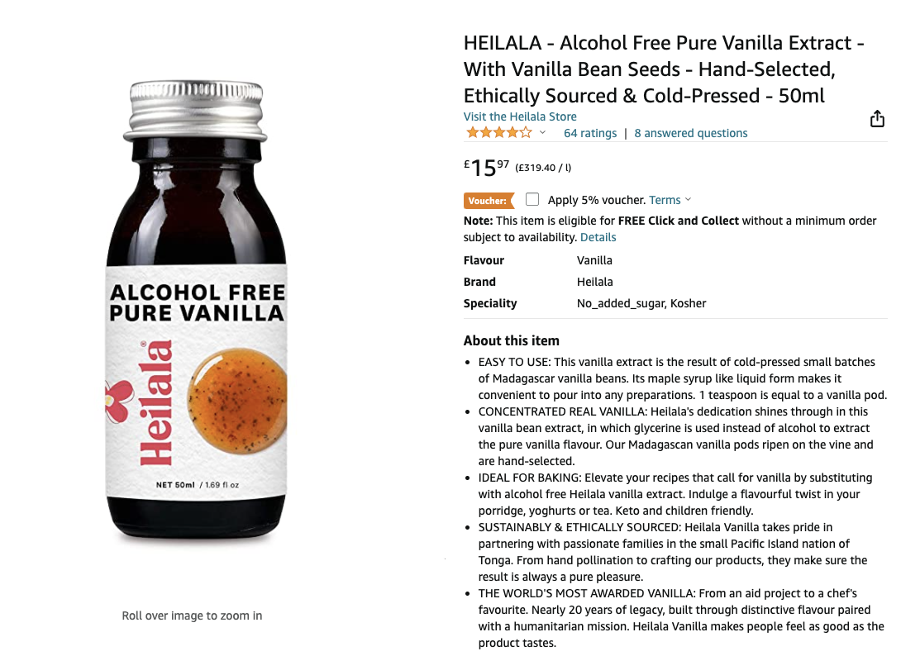
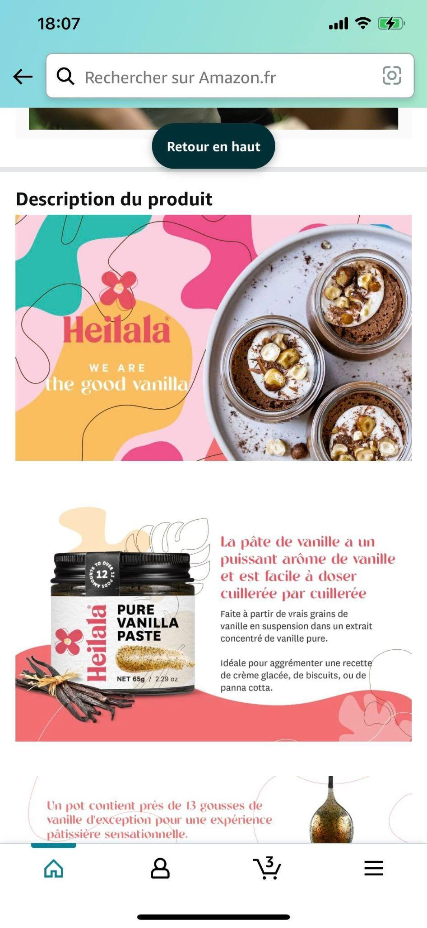
x
BRAND CONTENT CREATION
FOUNDATIONS

Slide 21
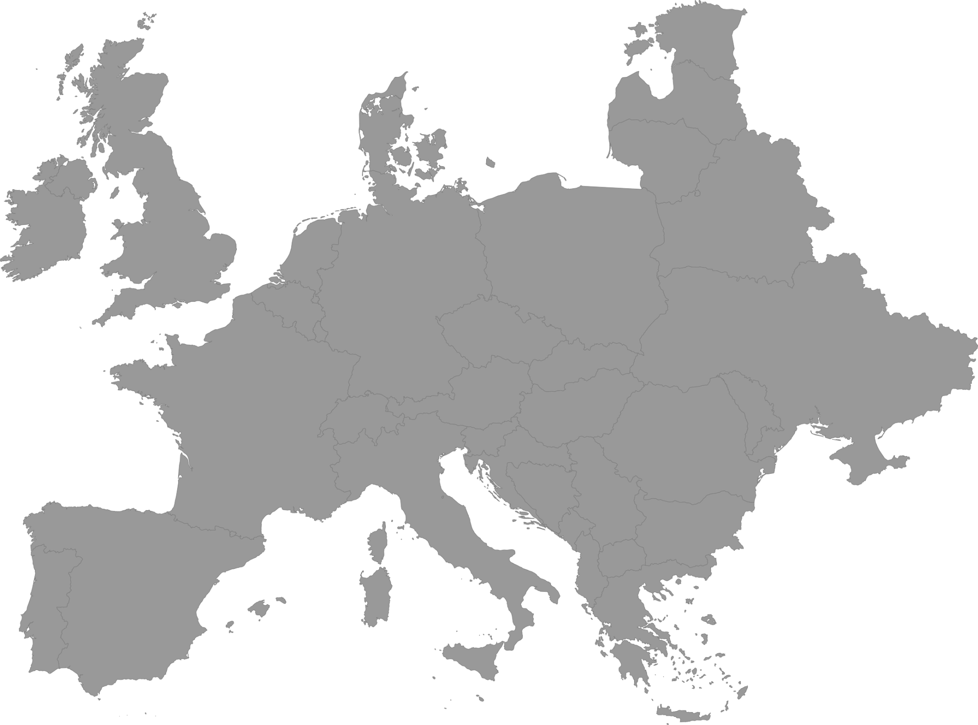
x
GLOBAL RELEVANCE, LOCAL RESONANCE
Exporting content to France
Resonate with target market
Amplify brand authenticity
Boost search visibility with keywords
Targeted translation is the starting point
to enhanced market penetration.
✓
Native translation
✓
Local keywords research
✓
Local recipe adaptation
Notes:
Global Relevance, Local Appeal: Our content creation approach ensures that your message is not only understood but resonates deeply with target audiences across diverse cultures, fostering stronger connections and engagement.
Cultural Storytelling for Impact: We leverage the power of cultural narratives to craft content that captivates and influences audiences, enabling your brand to stand out amidst global competition.
Multilingual SEO Domination: By combining translation with local marketing insights, we optimize your content for multiple languages, boosting search visibility and driving organic growth in various markets.
Adaptability and Expansion: Our approach allows your content to be easily adapted and localized for different regions, giving you the flexibility to expand your market reach while maintaining a consistent brand voice.
Resonance and Authenticity: Through our fusion of translation and local marketing, we create authentic content that respects cultural nuances, building trust and credibility with international audiences.

Slide 22
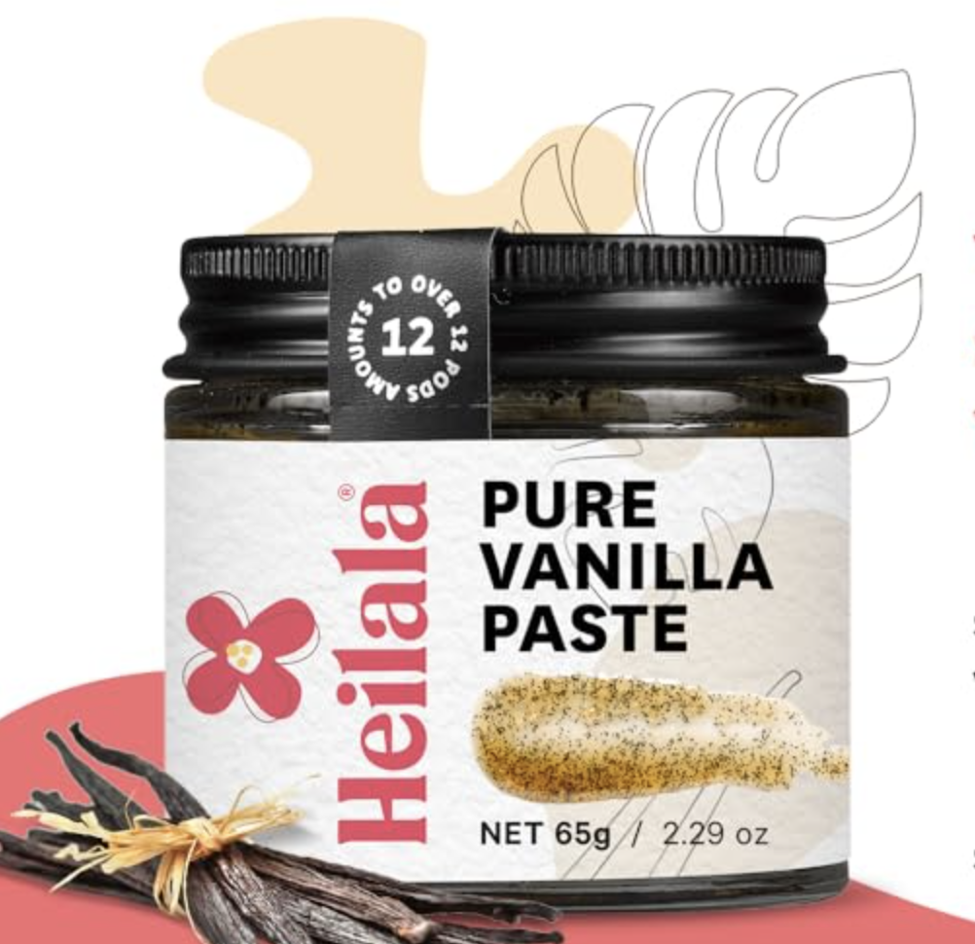
x
OVERALL
KPIs
+253%
x2
in clicks
in ROAS
over entire catalog
over entire catalog
+3pts
100%
in conversion
presence
over entire catalog
of listings in the TOP 100
+3648
+115%
category ranks
of search queries
in Grocery
+234
in Natural Extracts
that include brand name Heilala

Slide 23
Q&As
It’s your turn
?
?
?
?
Happy to answer your questions!

Slide 24
arnaud.dura@bizon.solutions
+33 1 76 42 07 70

